Slide 1
MODULE 5
CHAPTER 2 JDBC

Slide 2

Java DataBase Connectivity (JDBC)
➢JDBC stands for Java Database Connectivity, which is a standard Java API for database-independent connectivity between the Java programming language and a wide range of databases.
➢The JDBC library includes APIs for each of the tasks mentioned below that are commonly associated with database usage.
Making a connection to a database
Creating SQL or MySQL statements
Executing SQL or MySQL queries in the database
Viewing & Modifying the resulting records
2

Slide 3

JDBC Architecture
➢JDBC Architecture consists of two layers
JDBC API: This provides the application-to-JDBC Manager connection.
JDBC Driver API: This supports the JDBC Manager-to-Driver Connection.
➢The JDBC API uses a driver manager and database-specific drivers to provide transparent connectivity to heterogeneous databases.
➢The JDBC driver manager ensures that the correct driver is used to access each data source.

Slide 4
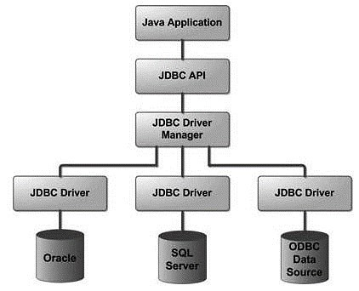
Following is the architectural diagram, which shows the location of the driver manager with respect to the JDBC drivers and the Java application
4

Slide 5
Java Database Connectivity with 5 Steps
➢There are 5 steps to connect any java application database using JDBC. These steps are as follows:
Register the Driver class
Create connection
Create statement
Execute queries
Close connection
with the

Slide 6
➢The forName() method is used to register the driver class.
➢The getConnection() method of DriverManager class is used to establish connection with the database
➢The createStatement() method of Connection interface is used to create statement. The object of statement is responsible to execute queries with the database.
➢The executeQuery() method of Statement interface is used to execute queries to the database. This method returns the object of ResultSet that can be used to get all the records of a table.
➢By closing connection object statement and ResultSet will be closed automatically. The close() method of Connection interface is used to close the connection.
6

Slide 7
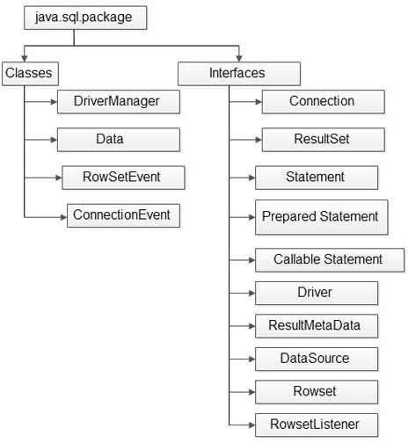

Slide 8
Creating and Executing Queries
Structured Query Language (SQL) is a standardized language that allows you to perform operations on a database, such as creating entries, reading content, updating content, and deleting entries.
SQL is supported by almost any database that is used, and it allows to write database code independently of the underlying database.
Create Database
Syntax
CREATE DATABASE databasename;
Eg:
CREATE DATABASE emp;
Drop Database
Syntax
DROP DATABASE databasename;
Eg:
DROP DATABASE emp;

Slide 9
Create Table
Syntax
CREATE TABLE table_name (column1 datatype(size), column2 datatype(size),…..);
Eg: CREATE TABLE Employees (id int NOT NULL, age int NOT NULL,first VARCHAR(10), last VARCHAR(10), PRIMARY KEY ( id ) ); /*The NOT NULL constraint enforces a column to NOT accept NULL values.*/
Drop Table
Syntax
DROP TABLE table_name;
Eg: DROP TABLE Employees;
INSERT Data
Syntax
INSERT INTO table_name VALUES (value1, value2, value3, ...);
Eg: INSERT INTO Employees VALUES (100, 18, 'Zara', 'Ali');

Slide 10
SELECT Data
Syntax
SELECT column1, column2, ...FROM table_name;
OR
SELECT * FROM table_name; // To select the whole table
Eg: SELECT first, last, age FROM Employees WHERE id = 100
UPDATE Data
Syntax
UPDATE table_name SET column1 = value1, column2 = value2, ... WHERE condition;
Eg: UPDATE Employees SET age=20 WHERE id=100;
DELETE Data
Syntax
DELETE FROM table_name WHERE condition;
Eg: DELETE FROM Employee WHERE id=100;

Slide 11
Java Database Connectivity with MySQL
To connect Java application with the MySQL database, we need to follow 5 following steps.
In this example we are using MySql as the database. So we need to know following informations for the mysql database:
Driver class: The driver class for the mysql database is com.mysql.jdbc.Driver.
Connection URL: The connection URL for the mysql database is jdbc:mysql://localhost:3306/sonoo where jdbc is the API, mysql is the database, localhost is the server name on which mysql is running, we may also use IP address, 3306 is the port number and sonoo is the database name. We may use any database, in such case, we need to replace the sonoo with our database

Slide 12
3. Username: The default username for the mysql database is root.
4. Password: It is the password given by the user at the time of installing the mysql database. In this example, we are going to use root as the password.
➢Let's first create a table in the mysql database, but before creating table, we need to create database first.
create database sonoo; use sonoo;
create table emp(id int(10),name varchar(40),age int(3));
8

Slide 13
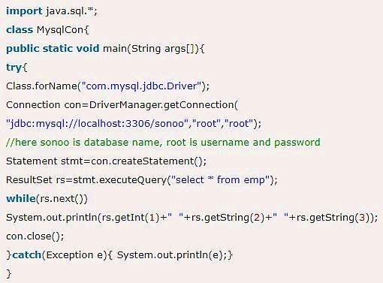
Example to Connect Java Application with mysql database
This example will fetch all the records of emp table.

Slide 14
Difference between Statement and PreparedStatement
1.Statement :
It is used for accessing your database. Statement interface cannot accept parameters and useful when you are using static SQL statements at runtime. If you want to run SQL query only once than this interface is preferred over PreparedStatement.
Eg) //Creating The Statement Object and then execute
Statement st = con.createStatement();
st.executeUpdate("CREATE TABLE STUDENT(ID NUMBER, NAME VARCHAR)");
2. PreparedStatement :
It is used when you want to use SQL statements many times. The PreparedStatement interface accepts input parameters at runtime.
Eg) //Creating the PreparedStatement object
PreparedStatement pst = con.prepareStatement("update STUDENT set NAME = ? where ID = ?"); //Set //values to place holders
pst.setString(1, "RAM"); //Assigns "RAM" to first place holder
pst.setInt(2, 512); //Assigns "512" to second place holder
pst.executeUpdate(); //Executing PreparedStatement

Slide 15
Creating a sample MySQL database
create database SampleDB; use SampleDB;
CREATE TABLE users (
user_id int(11) NOT NULL AUTO_INCREMENT,
username varchar(45) NOT NULL,
password varchar(45) NOT NULL,
fullname varchar(45) NOT NULL,
email varchar(45) NOT NULL, PRIMARY KEY (user_id)
);
10

Slide 16
Connecting to the database
String dbURL = "jdbc:mysql://localhost:3306/sampledb";
String username = "root";
String password = "secret";
try {
Connection conn = DriverManager.getConnection(dbURL, username, password);
if (conn != null) { System.out.println("Connected");
}
} catch (SQLException ex)
{
ex.printStackTrace();
}

Slide 17
Once the connection was established, we have a Connection object which can be used to create statements in order to execute SQL queries.
In the above code, we have to close the connection explicitly after finish working with the database:
conn.close();
INSERT Statement Example
Let’s write code to insert a new record into the table Users with following details:
username: bill password: secretpass fullname: Bill Gates
email: bill.gates@microsoft.com
12

Slide 18
String sql = "INSERT INTO Users (username, password, fullname, email) VALUES (?, ?, ?, ?)";
PreparedStatement statement = conn.prepareStatement(sql); statement.setString(1, "bill");
statement.setString(2, "secretpass"); statement.setString(3, "Bill Gates");
statement.setString(4, "bill.gates@microsoft.com"); int rowsInserted = statement.executeUpdate();
if (rowsInserted > 0) {
System.out.println("A new user was inserted successfully!");
}

Slide 19
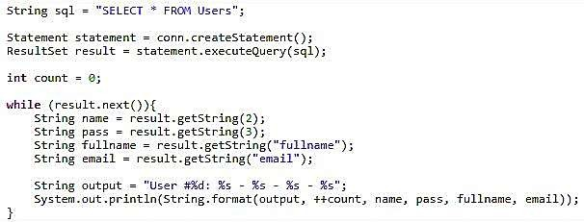
SELECT Statement Example
Output
User #1: bill - secretpass - Bill Gates - bill.gates@microsoft.com
14

Slide 20
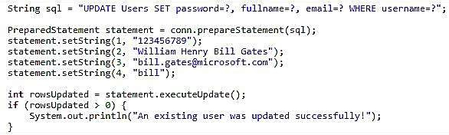
UPDATE Statement Example

Slide 21
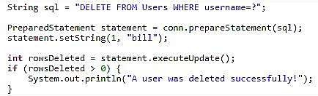
DELETE Statement Example
The following code snippet will delete a record whose username field contains “bill”
16

